Slide 1
Machine Theory of Mind (Deep Mind)
Helmut Wahanik
Waterloo Hydrogeologic
Instituto Nacional de Matemática Pura e Aplicada, Rio de Janeiro - Brazil

Slide 2
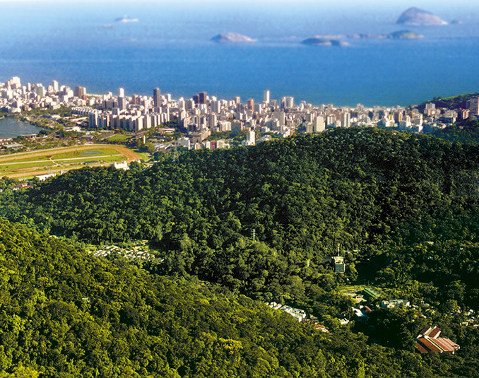
IMPA – Rio de Janeiro
-Research Dynamical Systems, Differential
Geometry, Applied Mathematics.
-2014 Fields Medal, Artur Avila, work in Dynamical Systems (Ten Martini Problem).
My work:
-Mathematical Physics - Fluid dynamics.
-Riemann problems - Numerical Shock Waves and Rarefactions waves in Gas Dynamics.
-Markov Chain Monte-Carlo methods (Seismic Tomography) – SLB- U. of Cambridge.
-Computational Geometry, U. of Calgary.

Slide 3
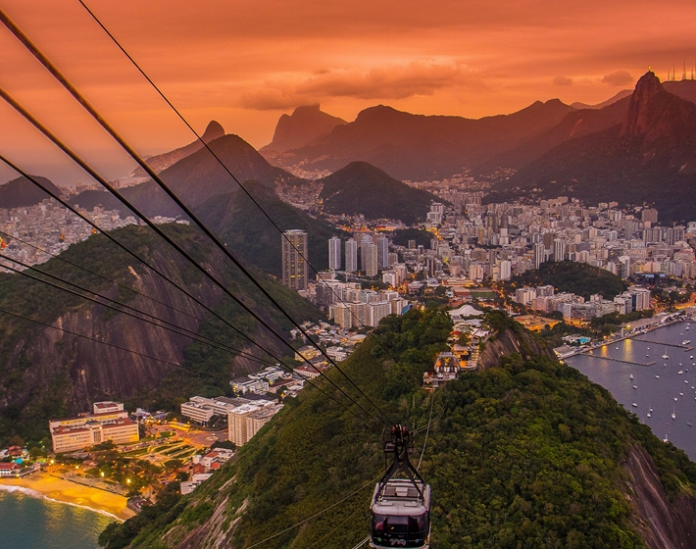
IMPA – Rio de Janeiro
-Research Dynamical Systems, Differential
Geometry, Applied Mathematics.
-2014 Fields Medal, Artur Avila, work in Dynamical Systems (Ten Martini Problem).
My work:
-Mathematical Physics - Fluid dynamics.
-Riemann problems - Numerical Shock Waves and Rarefactions waves in Gas Dynamics.
-Markov Chain Monte-Carlo methods (Seismic Tomography) – SLB- U. of Cambridge.
-Computational Geometry, U. of Calgary.

Slide 4
Collaboration RJ-MCMC - University of Cambridge - UK (Schlumberger).
-Travel-times built through Greens function approach and Seismic Ambient Noise.
-Voronoi grids updated across the random walk.
-Minimize difference of theoretical and experimental travel-times.
-Dimension is also variable, and adjust to complexity of the data.
-Samples are accepted or rejected with a modified Metropolis-Hastings algorithm, guiding the samples towards regions of higher probability (e.g. Langevin MCMC MALA).

Slide 5
-The 3D point-wise probability distribution across all chains is the final posterior => solution to inverse problem.
-The uncertainty of the solution can be measured by the spread of the samples.
-Fortran + OpenMPI + Qsub + SLB cluster.
-Parallelization on calculation of seismic travel-times => many seismometers.
-Mapping in GMT – Generic Mapping Tools.

Slide 6
-The 3D point-wise probability distribution across all chains is the final posterior => solution to inverse problem.
-The uncertainty of the solution can be measured by the spread of the samples.
-Fortran + OpenMPI + Qsub + SLB cluster.
-Parallelization on calculation of seismic travel-times => many seismometers.
-Mapping in GMT – Generic Mapping Tools.
Could this be implemented in TensorFlow Probability?

Slide 7

ToM-Net – Theory of Mind Neural Network
Observer: Uses Meta-learning to predict behaviors of agents living in a Grid-World (models other agents).
Objective: To rapidly form predictions about new agents from limited data and behavioral traces.
Players: Agents are themselves Deep Reinforcement Learning agents.
Important Feature:
To imitate cognitive predictive patterns of human mind.
-Passes “cognition” tests such as the Sally-Anne test.
Grid-world

Slide 8




Sally-Anne Test
3 year old
-Developmental psychology test, for measuring a person's social cognitive intelligence: ability to recognize that others have false beliefs about the world.
-Measure of higher intelligence in primates:
3 year old child fails it.
4 year old passes it.
Sound-proof
light-proof
scent-proof
barrier

Slide 9
Sally-Anne Test
What’s inside?
-Developmental psychology test, for measuring a person's social cognitive intelligence: ability to recognize that others have false beliefs about the world.
-Measure of higher intelligence in primates:
3 year old child fails it.
4 year old passes it.

Slide 10
Sally-Anne Test
Crayons
-Developmental psychology test, for measuring a person's social cognitive intelligence: ability to recognize that others have false beliefs about the world.
-Measure of higher intelligence in primates:
3 year old child fails it.
4 year old passes it.

Slide 11

Sally-Anne Test
Bones!
-Developmental psychology test, for measuring a person's social cognitive intelligence: ability to recognize that others have false beliefs about the world.
-Measure of higher intelligence in primates:
3 year old child fails it.
4 year old passes it.

Slide 12
Sally-Anne Test
-Developmental psychology test, for measuring a person's social cognitive intelligence: ability to recognize that others have false beliefs about the world.
-Measure of higher intelligence in primates:
3 year old child fails it.
4 year old passes it.
Remove
Snoopy-proof wall!

Slide 13
Sally-Anne Test
What does Snoopy
think is inside?
-Developmental psychology test, for measuring a person's social cognitive intelligence: ability to recognize that others have false beliefs about the world.
-Measure of higher intelligence in primates:
3 year old child fails it.
4 year old passes it.

Slide 14
Sally-Anne Test
Bones!
-Developmental psychology test, for measuring a person's social cognitive intelligence: ability to recognize that others have false beliefs about the world.
-Measure of higher intelligence in primates:
3 year old child fails it.
4 year old passes it.

Slide 15

Sally-Anne Test
-Developmental psychology test, for measuring a person's social cognitive intelligence: ability to recognize that others have false beliefs about the world.
-Measure of higher intelligence in primates:
3 year old child fails it.
4 year old passes it.

Slide 16

Sally-Anne Test
What does Snoopy
think is inside?
Repeat first 3 steps
with 4 year old
-Developmental psychology test, for measuring a person's social cognitive intelligence: ability to recognize that others have false beliefs about the world.
-Measure of higher intelligence in primates:
3 year old child fails it.
4 year old passes it.

Slide 17
Sally-Anne Test
Crayons!
-Developmental psychology test, for measuring a person's social cognitive intelligence: ability to recognize that others have false beliefs about the world.
-Measure of higher intelligence in primates:
3 year old child fails it.
4 year old passes it.

Slide 18

Sally-Anne Test
-Developmental psychology test, for measuring a person's social cognitive intelligence: ability to recognize that others have false beliefs about the world.
-Measure of higher intelligence in primates:
3 year old child fails it.
4 year old passes it.

Slide 19
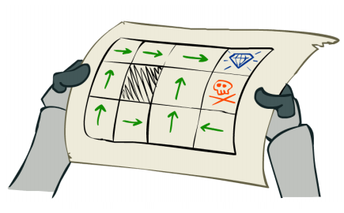
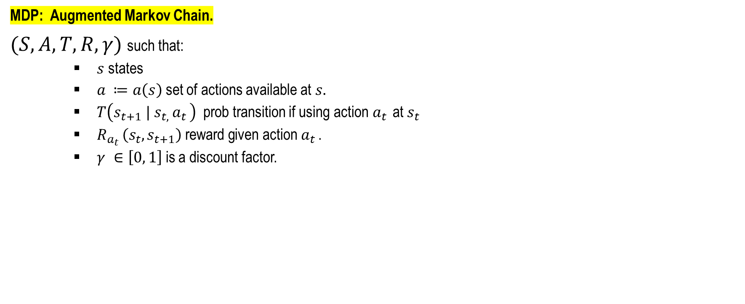
Preliminaries: Markov Decision Process
MDP: Augmented Markov Chain.
$(S, A, T, R, γ)$ such that:
$s$states
$a_{ }≔a\left(s\right)$ set of actions available at $s.$
$T\left(s_{t+1} | s_{t, }a_{t }\right)$ prob transition if using action$a_{t }$ at $s_{t }$
$R_{a_{t }}\left(s_{t},s_{t+1}\right)$ reward given action $a_{t }$.
$γ ∈\left[0, 1\right]$ is a discount factor.

Slide 20
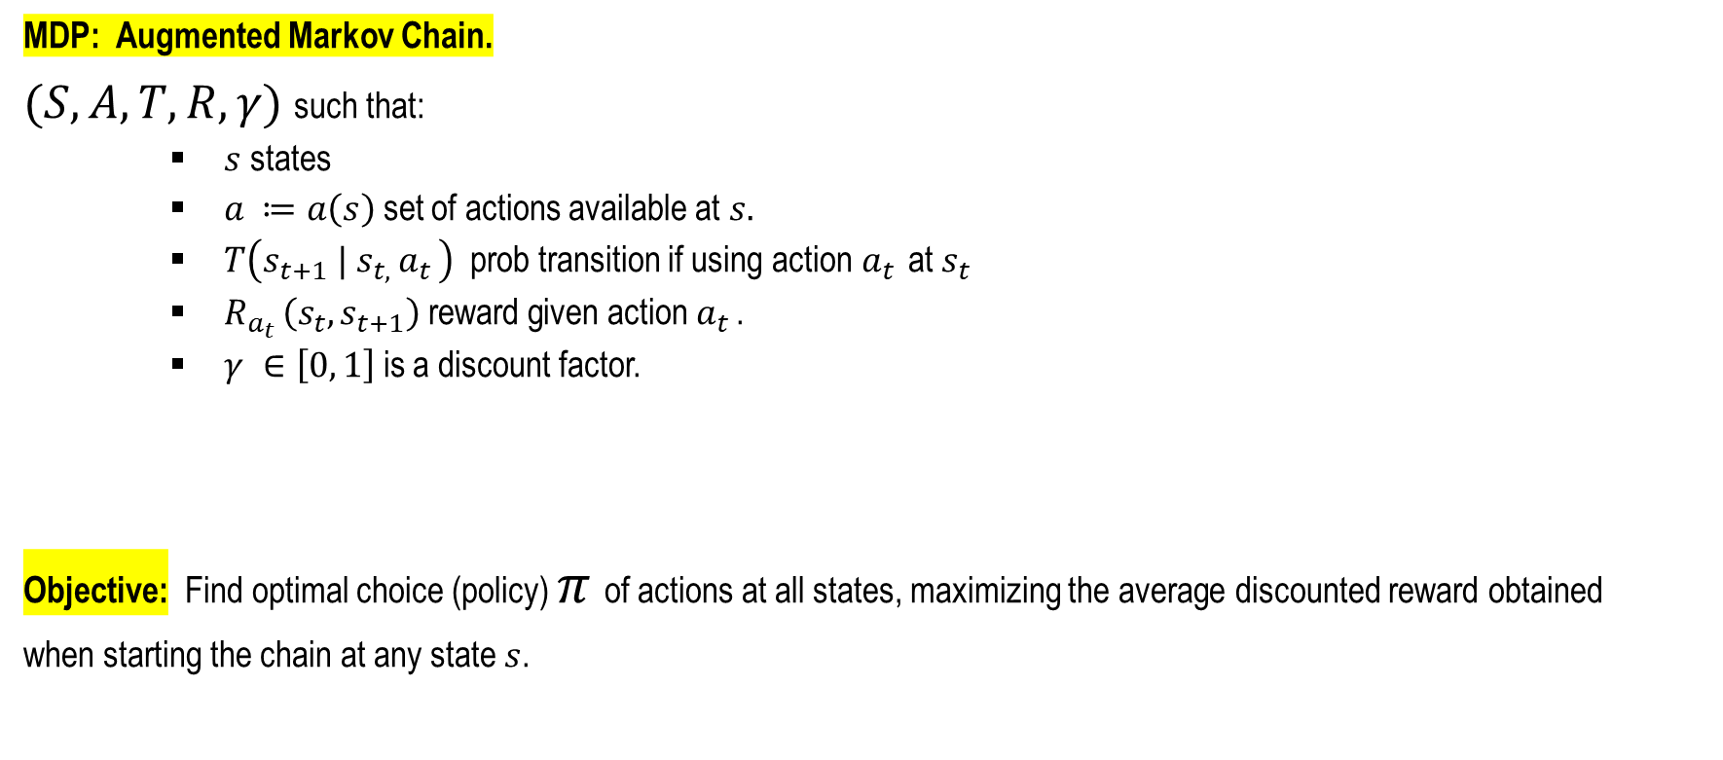
Preliminaries: Markov Decision Process
MDP: Augmented Markov Chain.
$(S, A, T, R, γ)$ such that:
$s$states
$a_{ }≔a\left(s\right)$ set of actions available at $s.$
$T\left(s_{t+1} | s_{t, }a_{t }\right)$ prob transition if using action$a_{t }$ at $s_{t }$
$R_{a_{t }}\left(s_{t},s_{t+1}\right)$ reward given action $a_{t }$.
$γ ∈\left[0, 1\right]$ is a discount factor.
Objective: Find optimal choice (policy) $π$ of actions at all states, maximizing the average discounted reward obtained
when starting the chain at any state $s$.

Slide 21
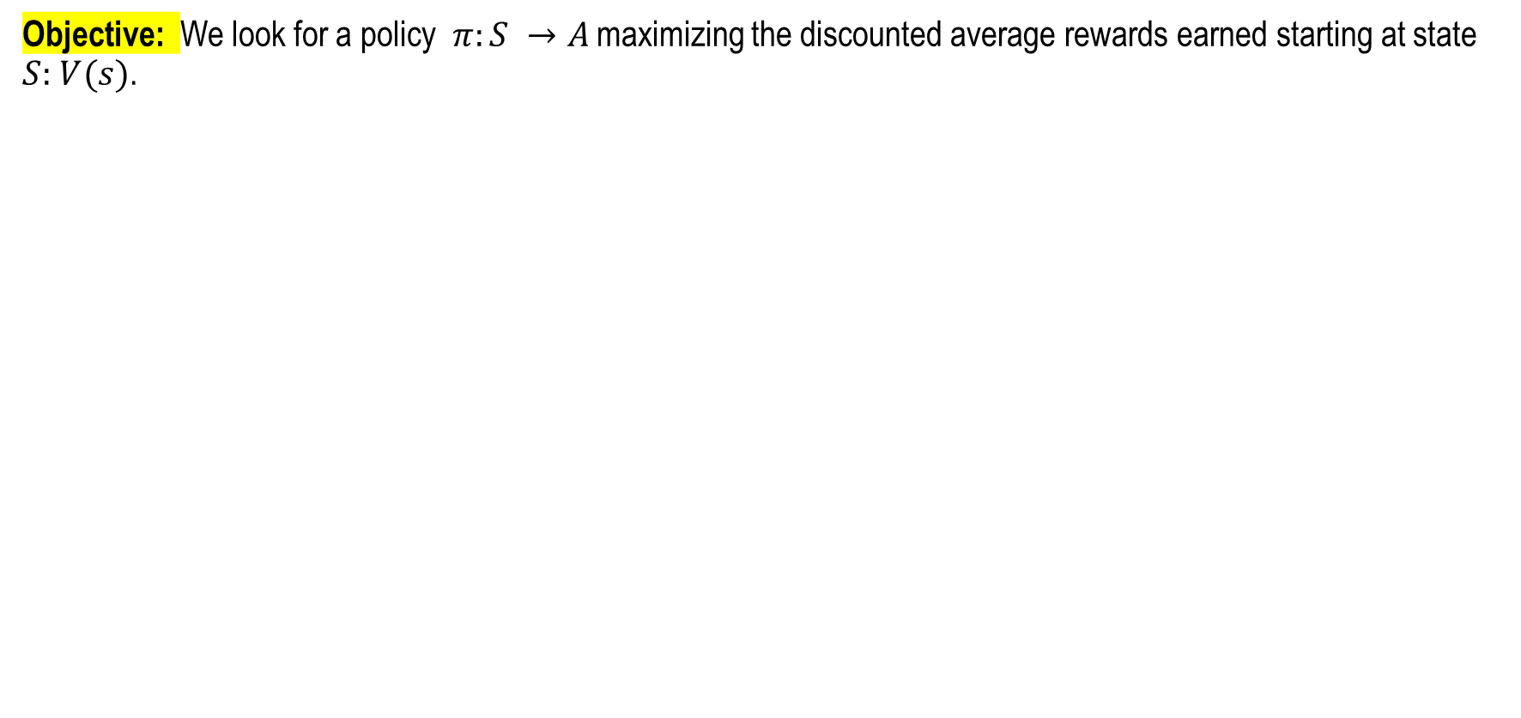
Preliminaries: Markov Decision Process
Objective: We look for a policy $π:S →A$ maximizing the discounted average rewards earned starting at state $S:$ $V(s)$.

Slide 22
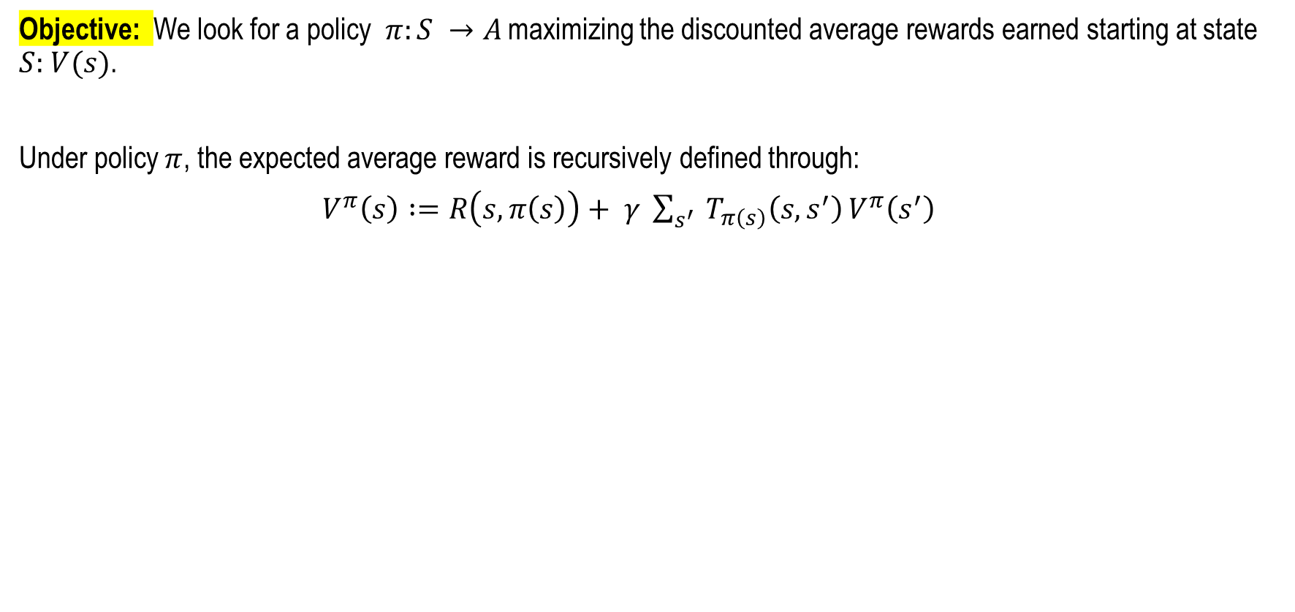
Preliminaries: Markov Decision Process
Objective: We look for a policy $π:S →A$ maximizing the discounted average rewards earned starting at state $S:$ $V(s)$.
Under policy $π$, the expected average reward is recursively defined through:
$V^{π}\left(s\right) :=R\left(s, π\left(s\right)\right)+ γ \sum_{s^{′}}{ T_{π\left(s\right)}\left(s,s^{′}\right)}V^{π}\left(s^{′}\right)$

Slide 23
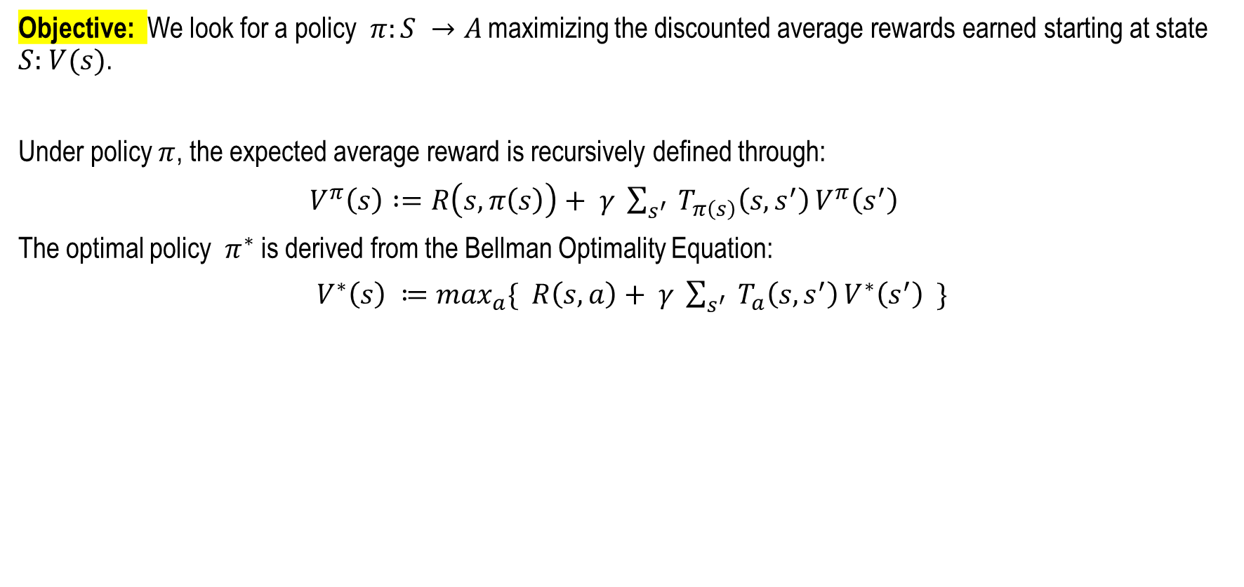
Preliminaries: Markov Decision Process
Objective: We look for a policy $π:S →A$ maximizing the discounted average rewards earned starting at state $S:$ $V(s)$.
Under policy $π$, the expected average reward is recursively defined through:
$V^{π}\left(s\right) :=R\left(s, π\left(s\right)\right)+ γ \sum_{s^{′}}{ T_{π\left(s\right)}\left(s,s^{′}\right)}V^{π}\left(s^{′}\right)$
The optimal policy $π^{∗}$ is derived from the Bellman Optimality Equation:
$V^{∗}\left(s\right) ≔\max_{a}\{ R\left(s, a\right)+ γ \sum_{s^{′}}{ T_{a}\left(s,s^{′}\right)}V^{∗}\left(s^{′}\right) \}$

Slide 24
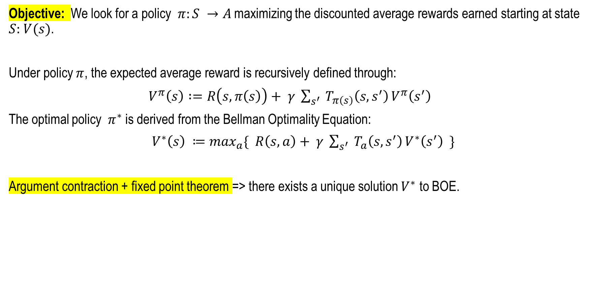
Preliminaries: Markov Decision Process
Objective: We look for a policy $π:S →A$ maximizing the discounted average rewards earned starting at state $S:$ $V(s)$.
Under policy $π$, the expected average reward is recursively defined through:
$V^{π}\left(s\right) :=R\left(s, π\left(s\right)\right)+ γ \sum_{s^{′}}{ T_{π\left(s\right)}\left(s,s^{′}\right)}V^{π}\left(s^{′}\right)$
The optimal policy $π^{∗}$ is derived from the Bellman Optimality Equation:
$V^{∗}\left(s\right) ≔\max_{a}\{ R\left(s, a\right)+ γ \sum_{s^{′}}{ T_{a}\left(s,s^{′}\right)}V^{∗}\left(s^{′}\right) \}$
Argument contraction + fixed point theorem => there exists a unique solution $V^{∗}$ to BOE.

Slide 25
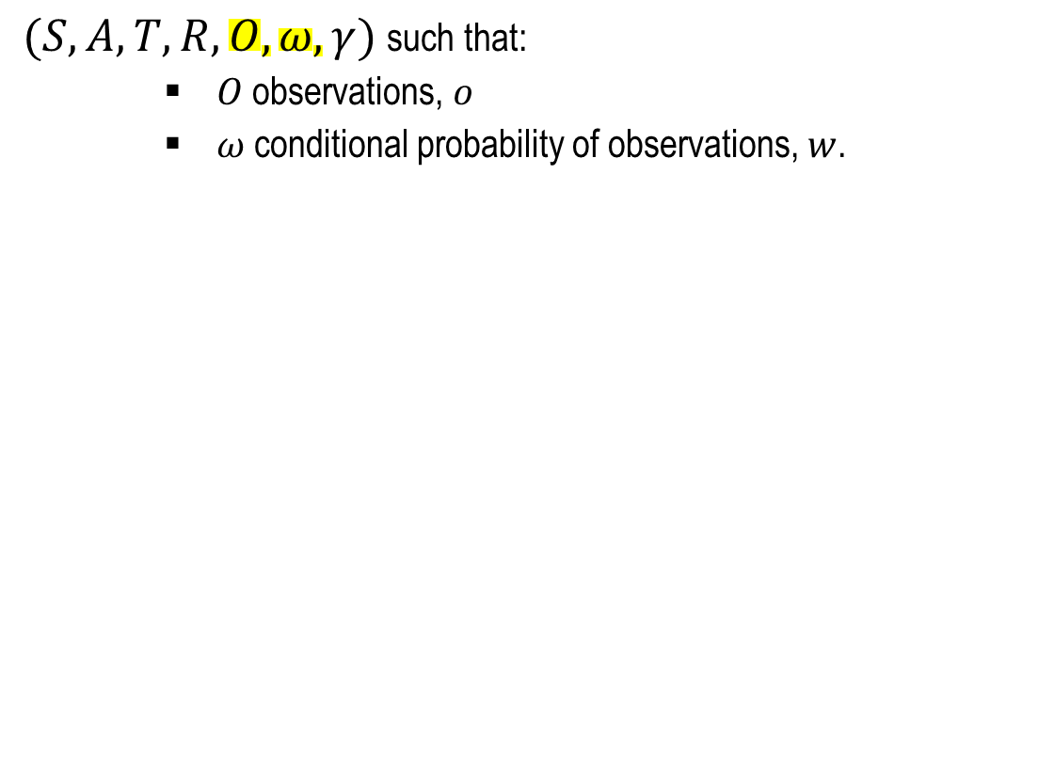
Partially Observable Markov Decision Process
$(S, A, T, R, O,ω, γ)$ such that:
$O$ observations, $o$
$ω$conditional probability of observations, $w$.

Slide 26
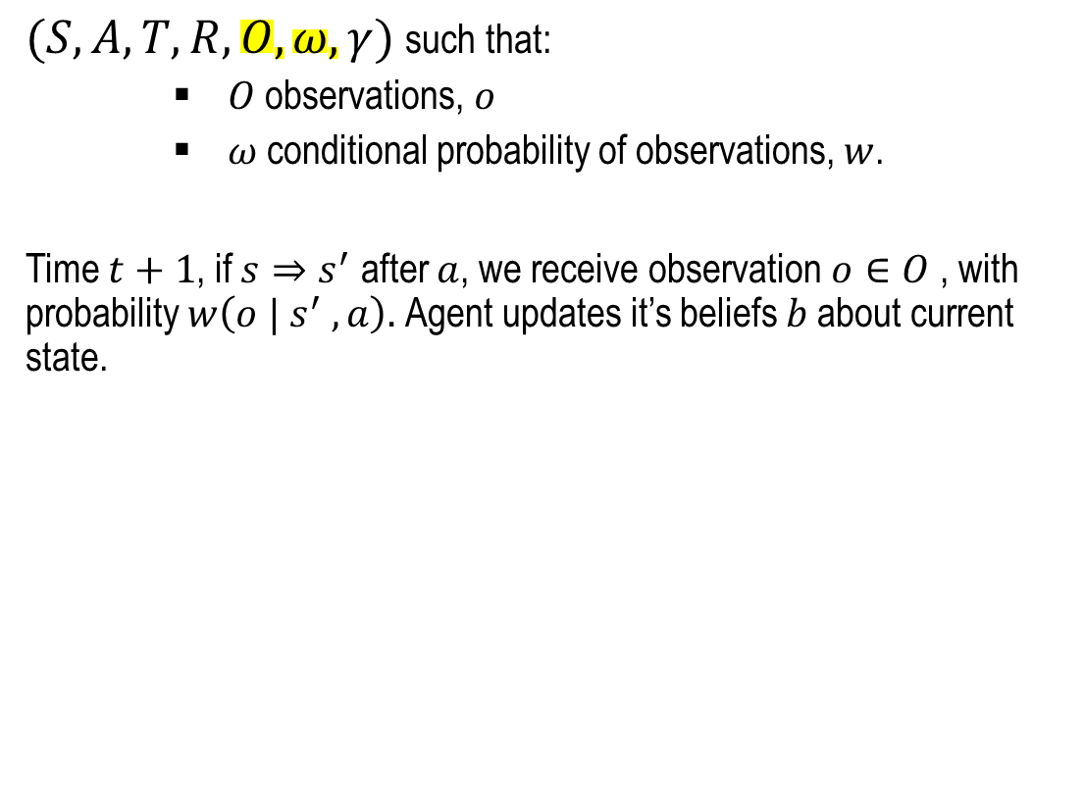
Partially Observable Markov Decision Process
$(S, A, T, R, O,ω, γ)$ such that:
$O$ observations, $o$
$ω$conditional probability of observations, $w$.
Time $t+1$, if $s⇒s^{′}$ after $a$, we receive observation $o∈O$, with probability $w\left(o |{ s}^{′} , a\right).$Agent updates it’s beliefs $b$about current state.

Slide 27
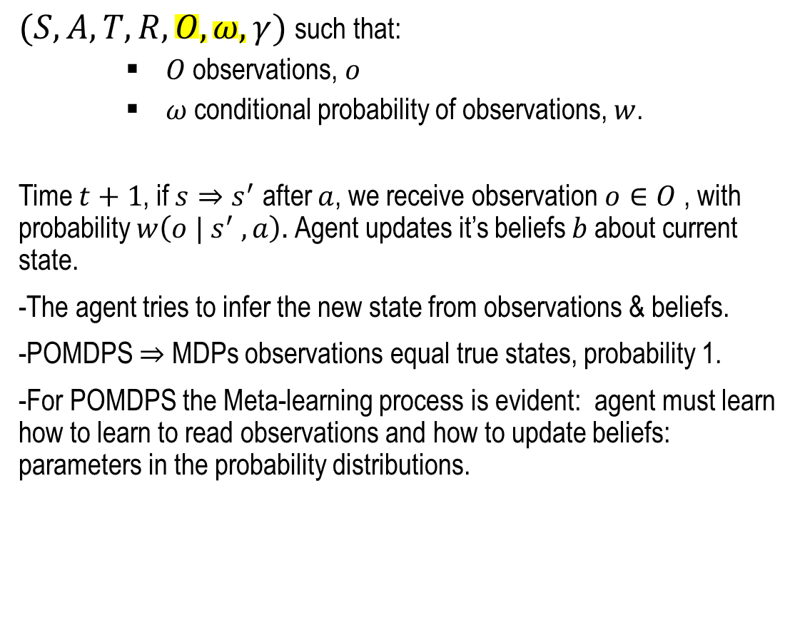
Partially Observable Markov Decision Process
$(S, A, T, R, O,ω, γ)$ such that:
$O$ observations, $o$
$ω$conditional probability of observations, $w$.
Time $t+1$, if $s⇒s^{′}$ after $a$, we receive observation $o∈O$, with probability $w\left(o |{ s}^{′} , a\right).$Agent updates it’s beliefs $b$about current state.
-The agent tries to infer the new state from observations & beliefs.
-POMDPS $⇒$ MDPs observations equal true states, probability 1.
-For POMDPS the Meta-learning process is evident: agent must learn how to learn to read observations and how to update beliefs: parameters in the probability distributions.

Slide 28
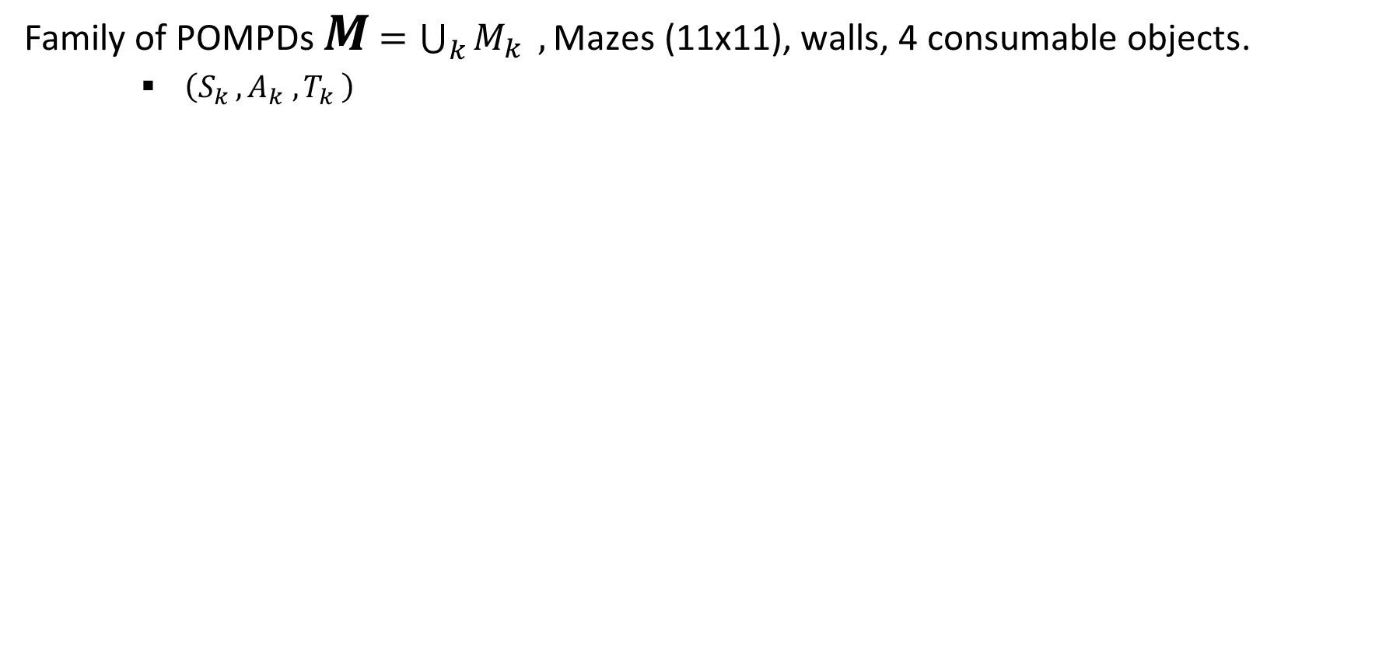
The Machine Theory of Mind Architecture
Family of POMPDs $M$ $=\bigcup_{k}{M_{k}} ,\text{Mazes}\text{ (}\text{11}\text{x}\text{11)}\text{, }\text{walls}\text{, 4 }\text{consumable} \text{objects}\text{.}$
$\left(S_{k }, A_{k} ,T_{k }\right)$

Slide 29
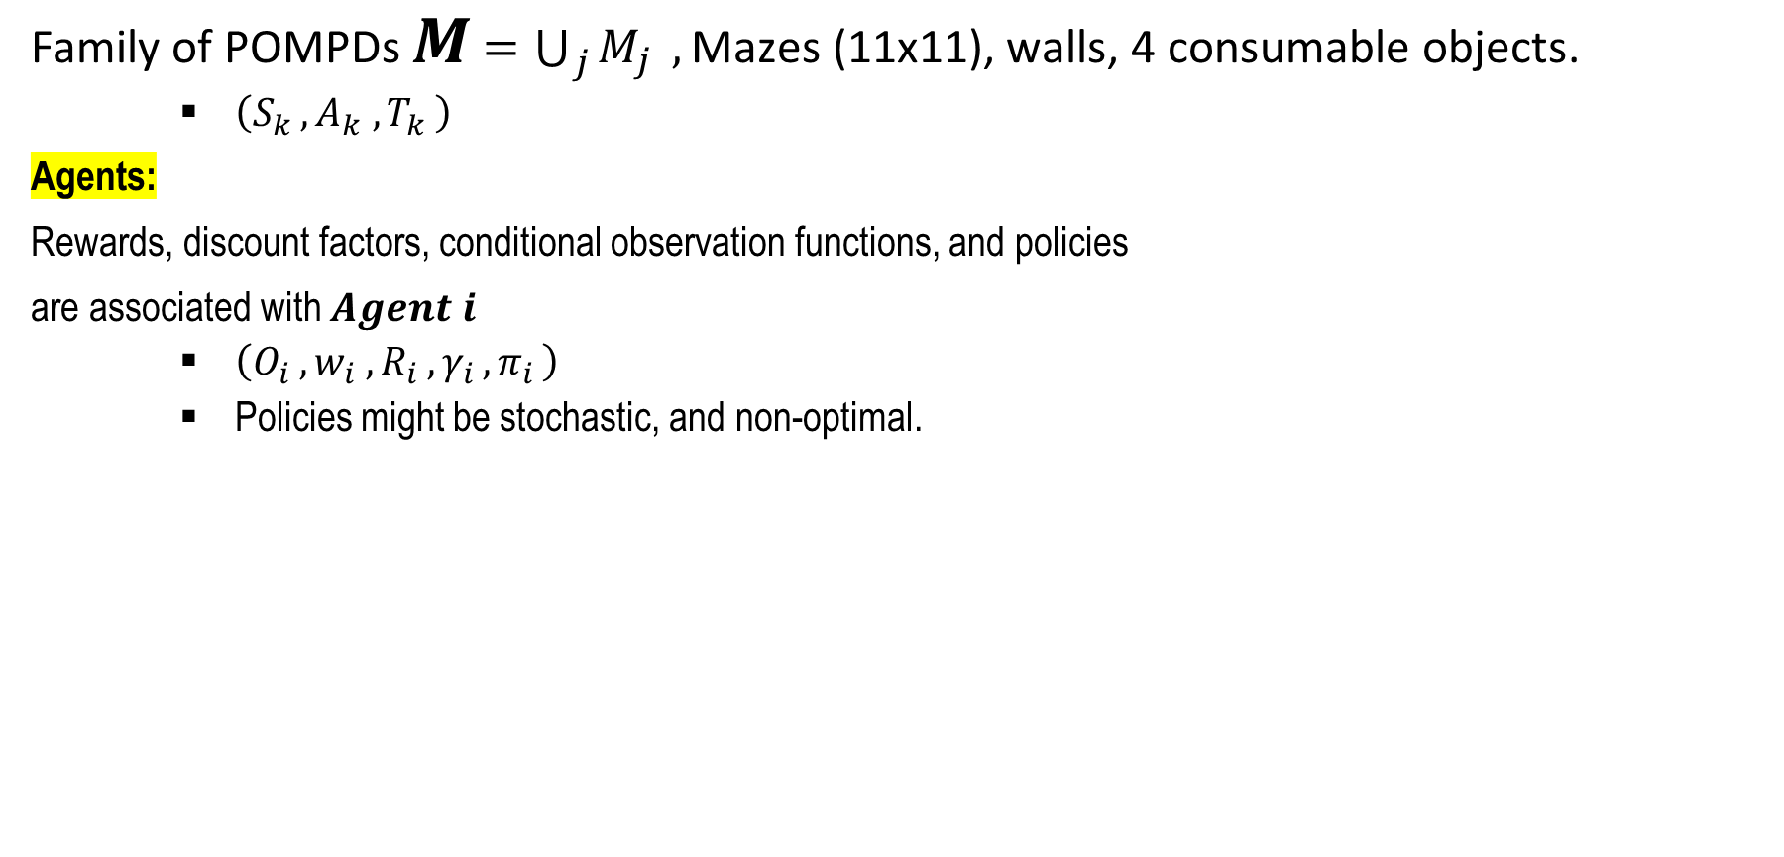
The Machine Theory of Mind Architecture
Family of POMPDs $M$ $=\bigcup_{j}{M_{j}} ,\text{Mazes}\text{ (11}\text{x}\text{11), }\text{walls}\text{, 4 }\text{consumable} \text{objects}\text{.}$
$\left(S_{k }, A_{k} ,T_{k }\right)$
Agents:
Rewards, discount factors, conditional observation functions, and policies
are associated with $Agent i$
$\left(O_{i }, w_{i} ,R_{i }, γ_{i },π_{i }\right)$
Policies might be stochastic, and non-optimal.

Slide 30
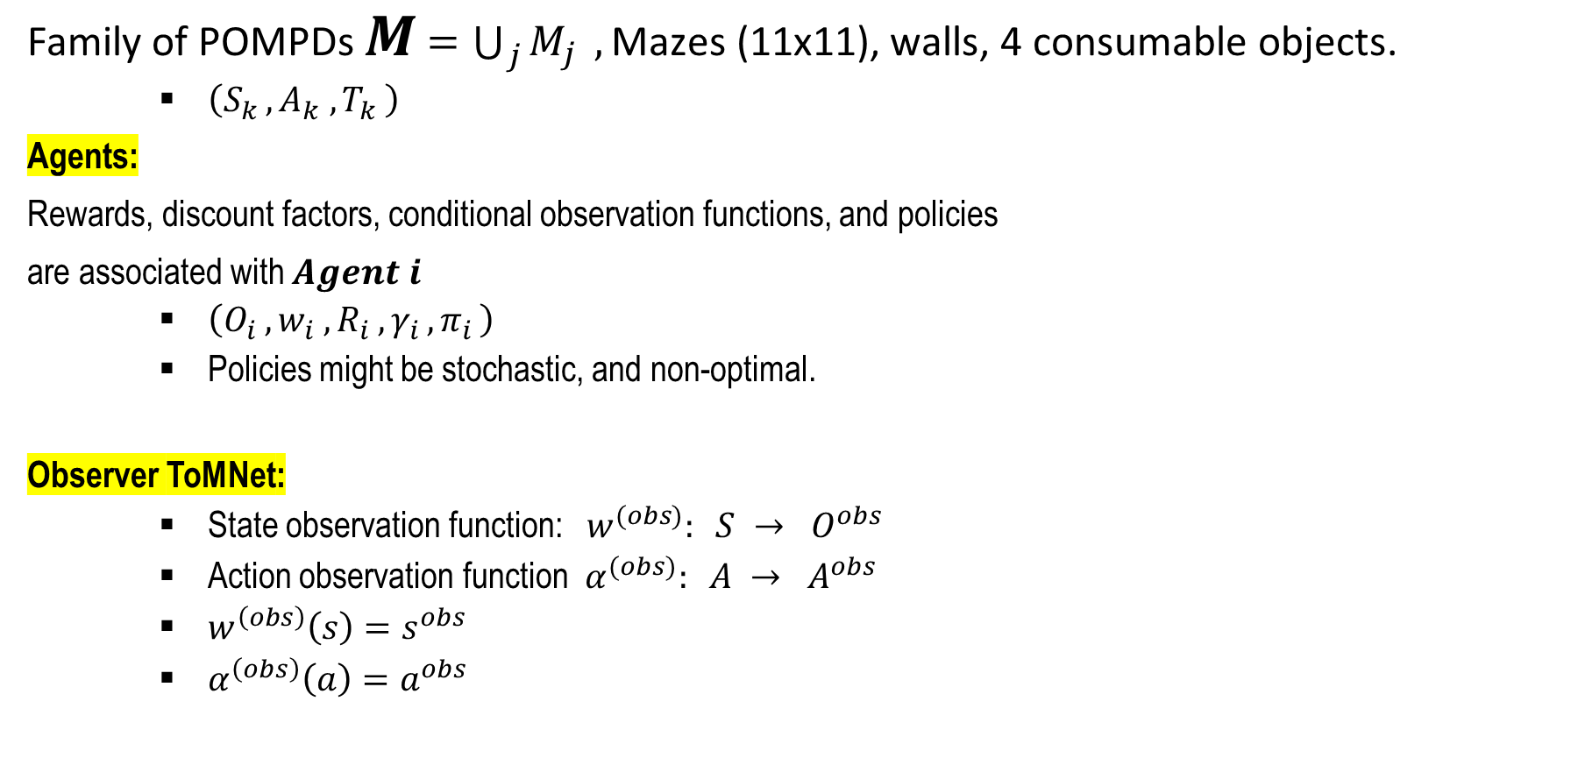
The Machine Theory of Mind Architecture
Family of POMPDs $M$ $=\bigcup_{j}{M_{j}} ,\text{Mazes}\text{ (11}\text{x}\text{11), }\text{walls}\text{, 4 }\text{consumable} \text{objects}\text{.}$
$\left(S_{k }, A_{k} ,T_{k }\right)$
Agents:
Rewards, discount factors, conditional observation functions, and policies
are associated with $Agent i$
$\left(O_{i }, w_{i} ,R_{i }, γ_{i },π_{i }\right)$
Policies might be stochastic, and non-optimal.
Observer ToMNet:
State observation function: $w^{(obs)}: S → O^{obs}$
Action observation function $α^{(obs)}: A → A^{obs}$
$w^{\left(obs\right)}\left(s\right)=s^{obs}$
$α^{\left(obs\right)}\left(a\right)=a^{obs}$

Slide 31
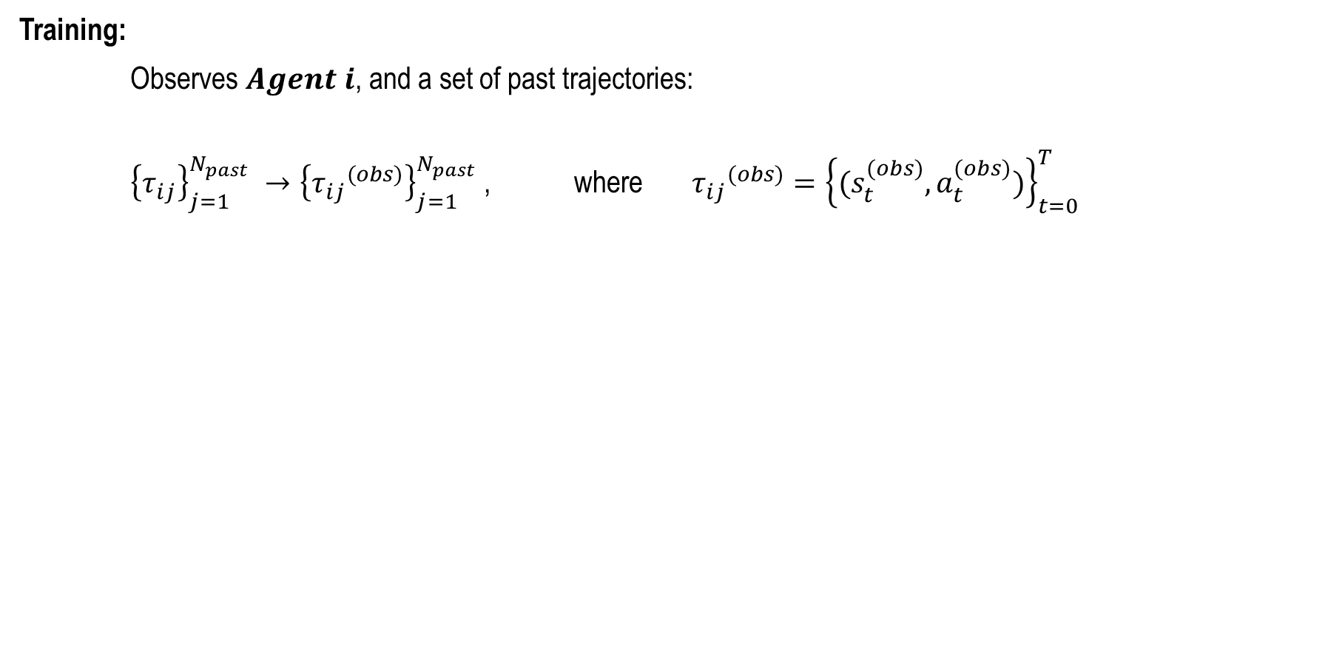
Observer’s Architecture
Training:
Observes $Agent i$, and a set of past trajectories:
${\left\{τ_{ij}\right\}}_{j=1}^{N_{past}} →{\left\{{τ_{ij}}^{(obs)}\right\}}_{j=1}^{N_{past}}$ , where ${τ_{ij}}^{(obs)}={\left\{(s_{t}^{(obs)},a_{t}^{(obs)})\right\}}_{t=0}^{T}$

Slide 32
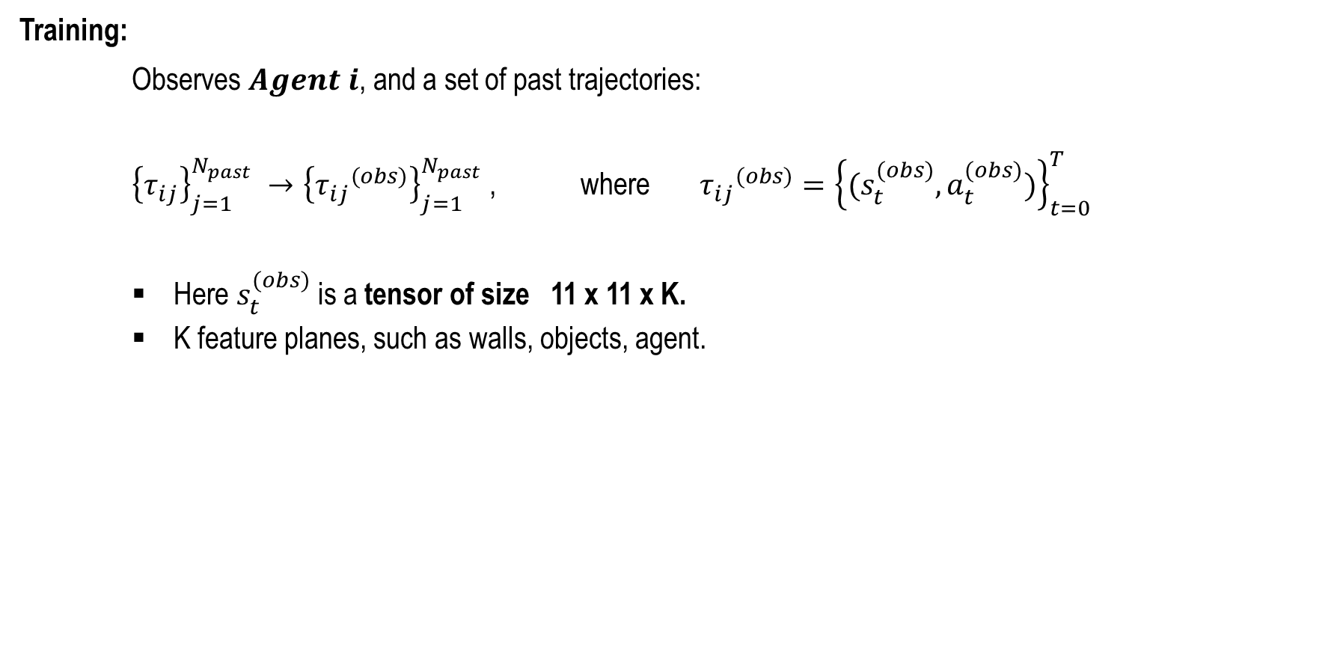
Observer’s Architecture
Training:
Observes $Agent i$, and a set of past trajectories:
${\left\{τ_{ij}\right\}}_{j=1}^{N_{past}} →{\left\{{τ_{ij}}^{(obs)}\right\}}_{j=1}^{N_{past}}$ , where ${τ_{ij}}^{(obs)}={\left\{(s_{t}^{(obs)},a_{t}^{(obs)})\right\}}_{t=0}^{T}$
Here $s_{t}^{(obs)}$ is a tensor of size 11 x 11 x K.
K feature planes, such as walls, objects, agent.

Slide 33
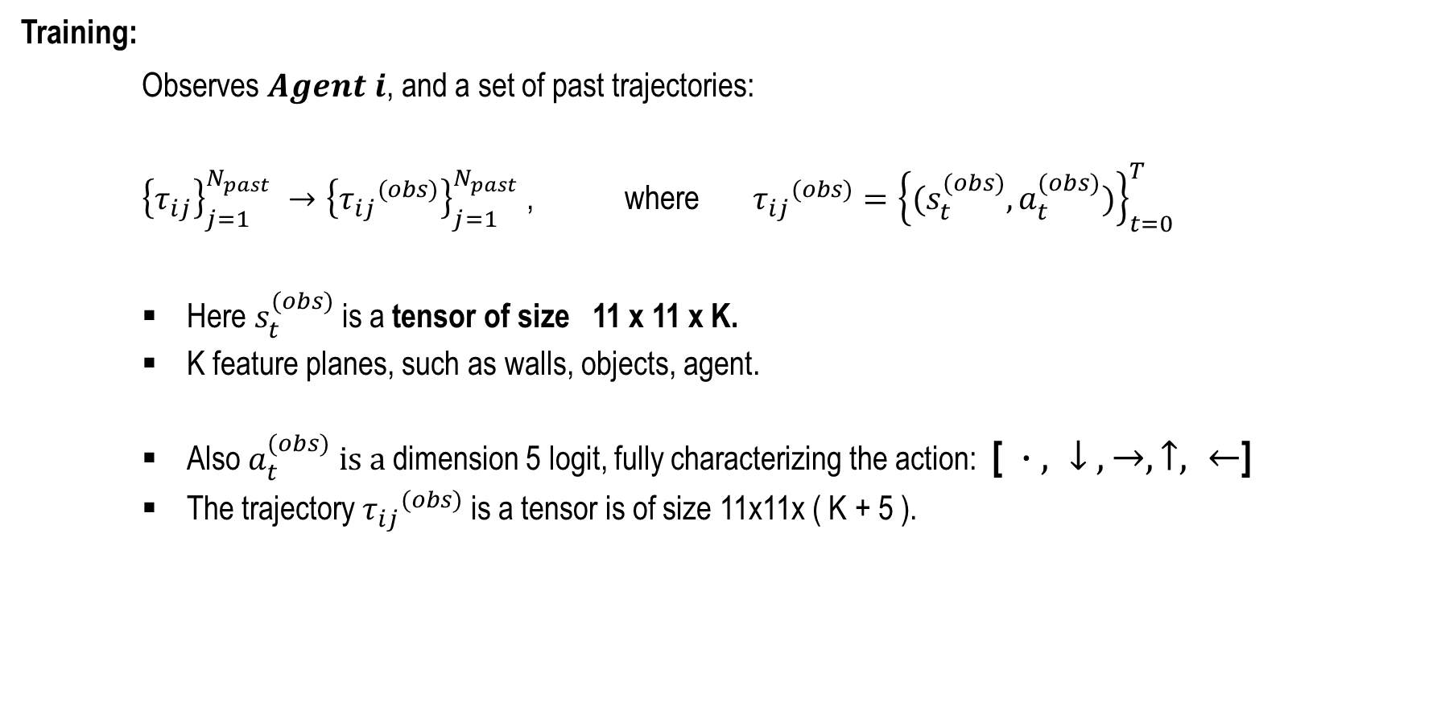
Observer’s Architecture
Training:
Observes $Agent i$, and a set of past trajectories:
${\left\{τ_{ij}\right\}}_{j=1}^{N_{past}} →{\left\{{τ_{ij}}^{(obs)}\right\}}_{j=1}^{N_{past}}$ , where ${τ_{ij}}^{(obs)}={\left\{(s_{t}^{(obs)},a_{t}^{(obs)})\right\}}_{t=0}^{T}$
Here $s_{t}^{(obs)}$ is a tensor of size 11 x 11 x K.
K feature planes, such as walls, objects, agent.
Also $a_{t}^{(obs)} is a$dimension 5 logit, fully characterizing the action: [ $∙ , ↓ , →, ↑, ←$]
The trajectory ${τ_{ij}}^{(obs)}$ is a tensor is of size 11x11x ( K + 5 ).

Slide 34
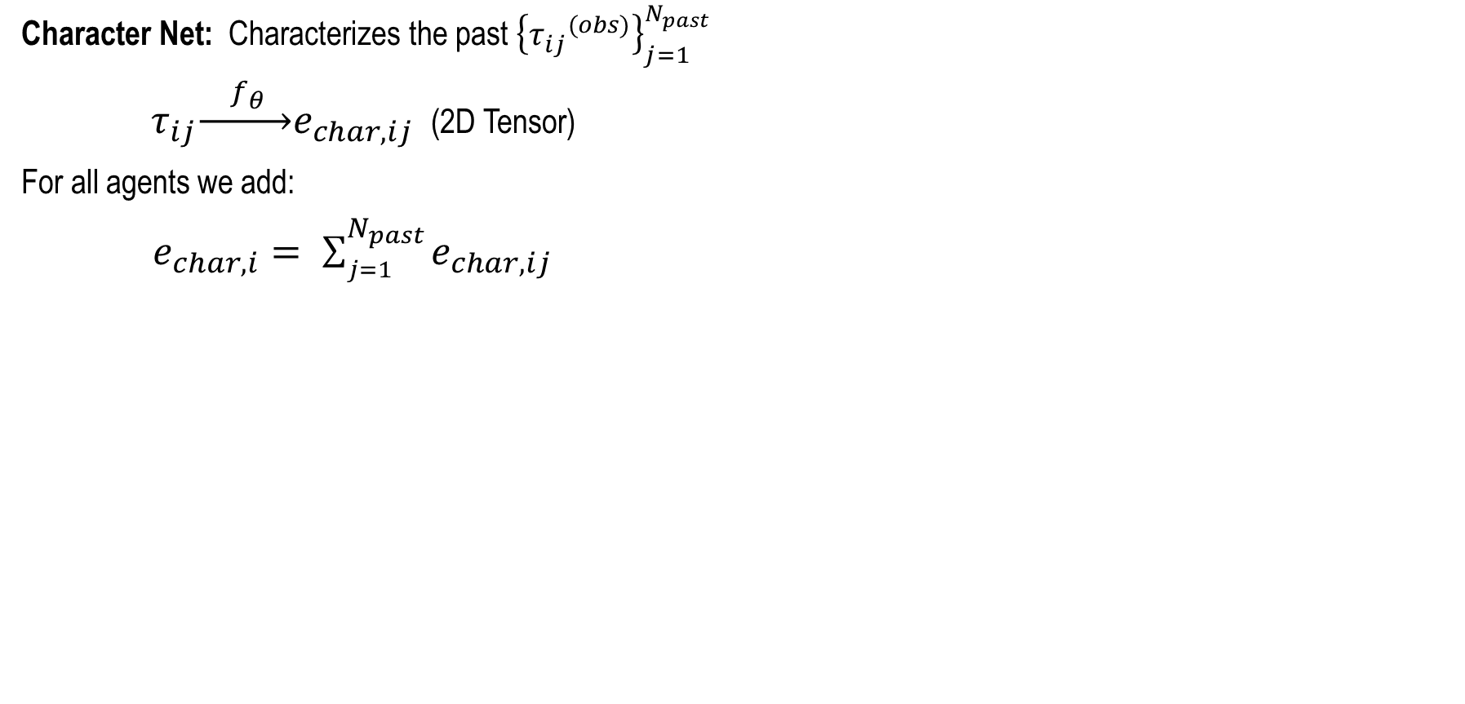
Observer’s Neural Net
Character Net: Characterizes the past ${\left\{{τ_{ij}}^{(obs)}\right\}}_{j=1}^{N_{past}}$
$τ_{ij}\underset{→}{ f_{θ }}e_{char, ij}$ (2D Tensor)
For all agents we add:
$e_{char, i}= \sum_{j=1}^{N_{past}}{e_{char, ij}}$

Slide 35
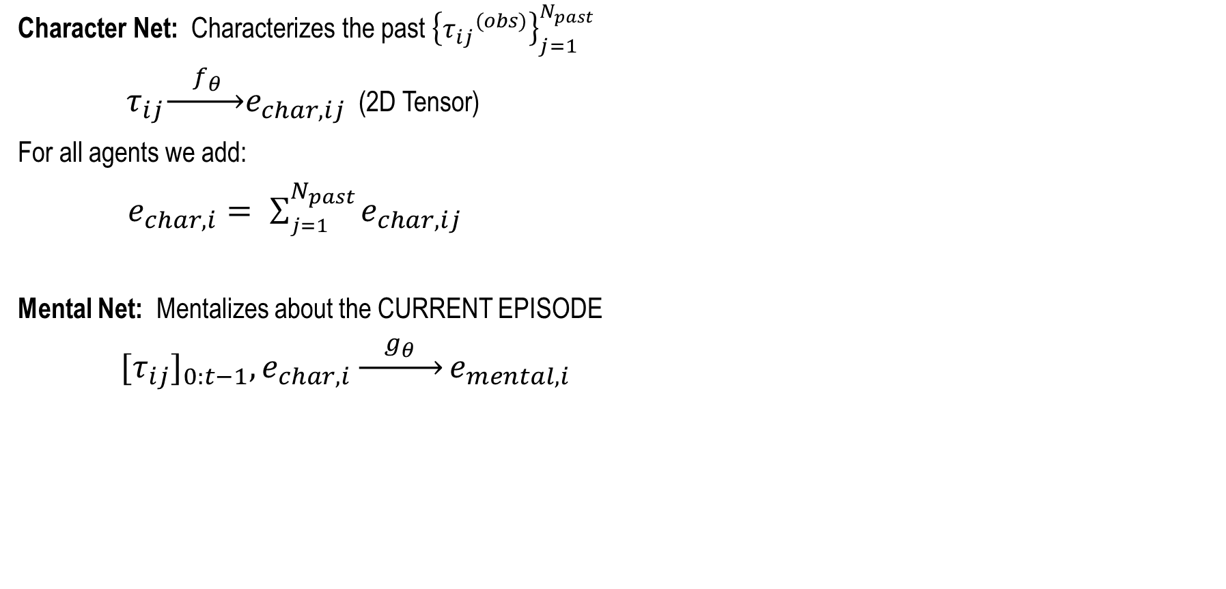
Observer’s Neural Net
Character Net: Characterizes the past ${\left\{{τ_{ij}}^{(obs)}\right\}}_{j=1}^{N_{past}}$
$τ_{ij}\underset{→}{ f_{θ} }e_{char, ij}$ (2D Tensor)
For all agents we add:
$e_{char, i}= \sum_{j=1}^{N_{past}}{e_{char, ij}}$
Mental Net: Mentalizes about the CURRENT EPISODE
${{[τ}_{ij}]}_{0:t−1},e_{char, i}\underset{→}{{ g}_{θ} }e_{mental, i}$

Slide 36
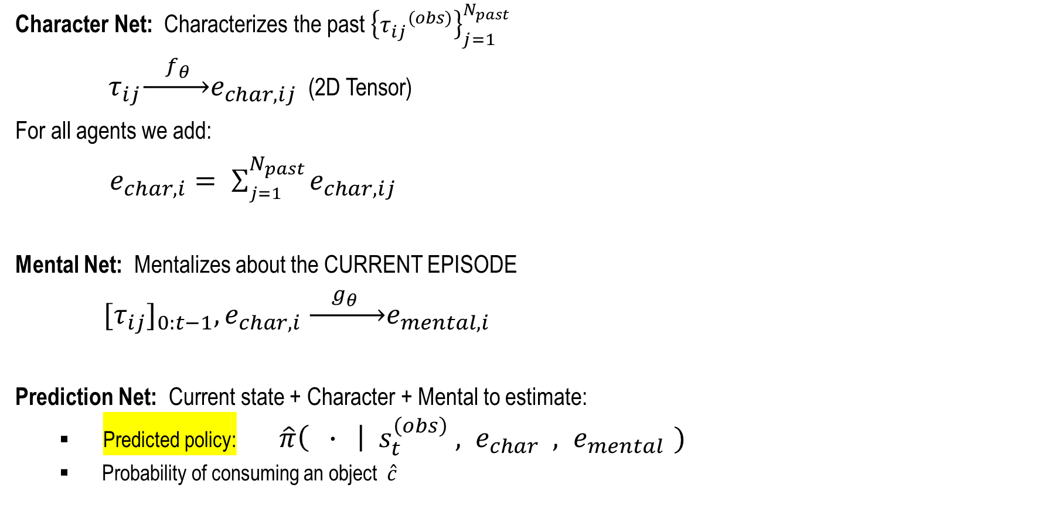
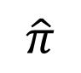
Observer’s Neural Net
Character Net: Characterizes the past ${\left\{{τ_{ij}}^{(obs)}\right\}}_{j=1}^{N_{past}}$
$τ_{ij}\underset{→}{ f_{θ }}e_{char, ij}$ (2D Tensor)
For all agents we add:
$e_{char, i}= \sum_{j=1}^{N_{past}}{e_{char, ij}}$
Mental Net: Mentalizes about the CURRENT EPISODE
${{[τ}_{ij}]}_{0:t−1},e_{char, i} \underset{→}{ g_{θ } }e_{mental, i}$
Prediction Net: Current state + Character + Mental to estimate:
Predicted policy: $\hat{π}\left( ∙ \right| s_{t}^{\left(obs\right)} , e_{char} , e_{mental })$
Probability of consuming an object $\hat{c}$
$$\hat{π}$$

Slide 37
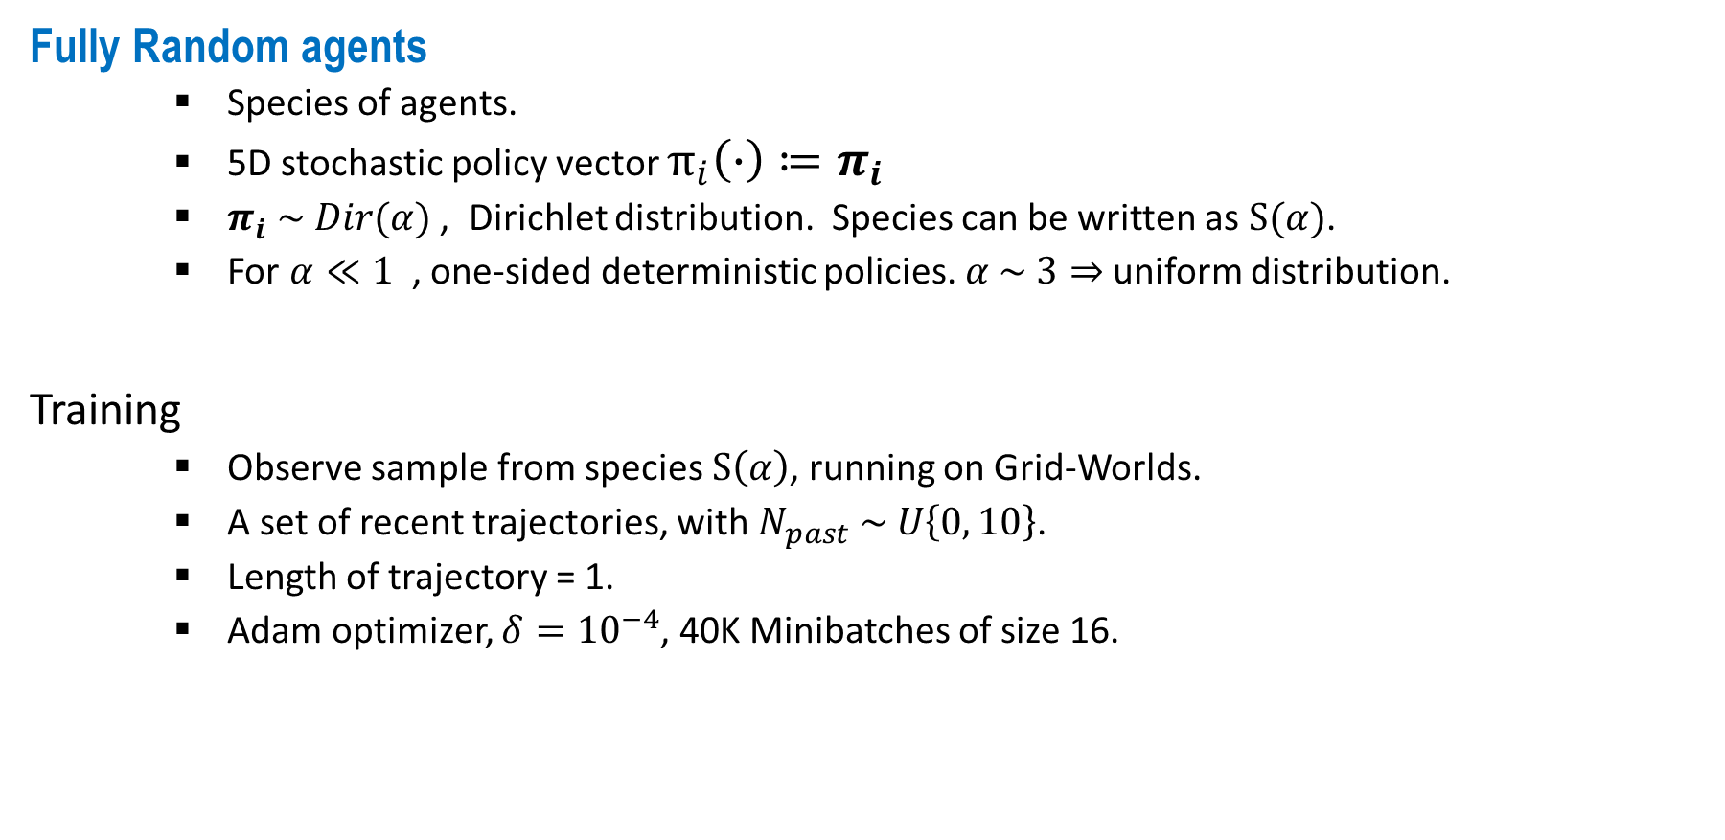
Experiments
Fully Random agents
Species of agents.
5D stochastic policy vector $π_{i}\left(∙\right)≔π_{i}$
$π_{i} \sim Dir(α)$ , Dirichlet distribution. Species can be written as $S(α)$.
For $α≪1$, one-sided deterministic policies. $α \sim 3⇒$uniform distribution.
Training
Observe sample from species $S\left(α\right)$, running on Grid-Worlds.
A set of recent trajectories, with $N_{past} \sim U\left\{0, 10\right\}$.
Length of trajectory = 1.
Adam optimizer, $δ={10}^{−4}$, 40K Minibatches of size 16.

Slide 38
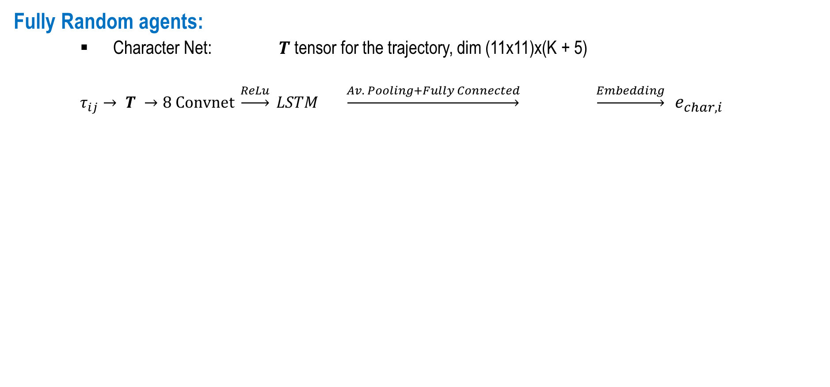
Architecture
Fully Random agents:
Character Net: $T$ tensor for the trajectory, dim (11x11)x(K + 5)
$τ_{ij}→ T →8 Convnet \underset{→}{ReLu} LSTM \underset{→}{Av. Pooling+Fully Connected} \underset{→}{Embedding}$ $e_{char, i}$

Slide 39
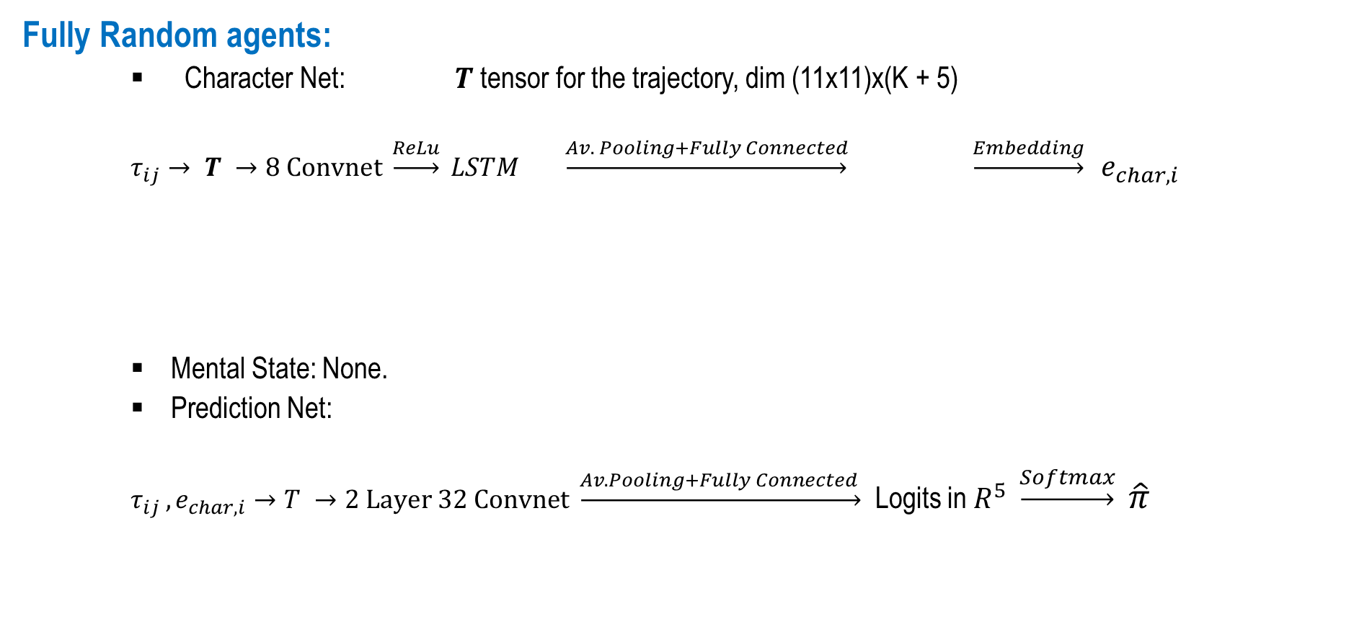
Architecture
Fully Random agents:
Character Net: $T$ tensor for the trajectory, dim (11x11)x(K + 5)
$τ_{ij}→ T →8 Convnet \underset{→}{ReLu} LSTM \underset{→}{Av. Pooling+Fully Connected} \underset{→}{Embedding}$ $e_{char, i}$
Mental State: None.
Prediction Net:
$τ_{ij },e_{char, i}→T →2 Layer 32 Convnet \underset{→}{Av. Pooling+Fully Connected }$ Logits in $R^{5} \underset{→}{Softmax}$ $\hat{π}$

Slide 40
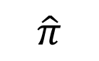
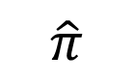
Random agent Training
Predicted action
Partial past trajectory
Current state
$$\hat{π}$$
$$\hat{π}$$

Slide 41
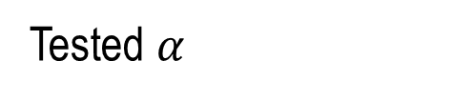
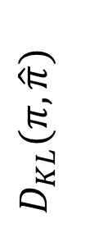
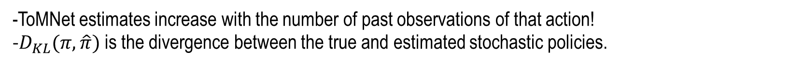
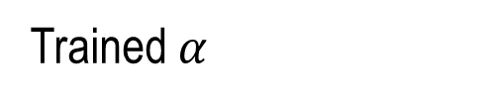
Random agent Training
Estimated
prob. of
performing an action
$D_{KL}(π, \hat{π})$
Trained $α$
Tested $α$
-ToMNet estimates increase with the number of past observations of that action!
-$D_{KL}(π, \hat{π})$ is the divergence between the true and estimated stochastic policies.

Slide 42
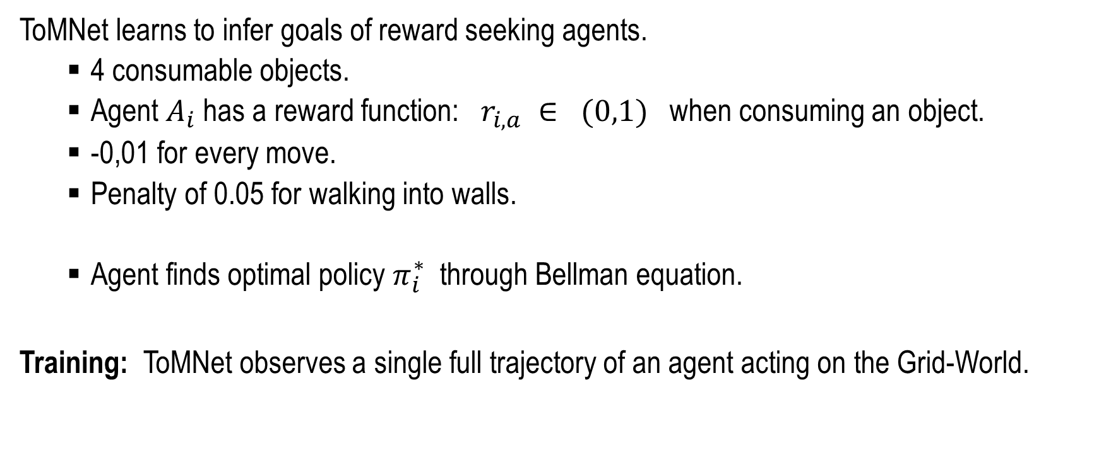
Inferring goal-directed behaviour
ToMNet learns to infer goals of reward seeking agents.
4 consumable objects.
Agent $A_{i}$ has a reward function: $r_{i,a} ∈ (0,1)$ when consuming an object.
-0,01 for every move.
Penalty of 0.05 for walking into walls.
Agent finds optimal policy $π_{i}^{∗}$ through Bellman equation.
Training: ToMNet observes a single full trajectory of an agent acting on the Grid-World.

Slide 43
Inferring goal-directed behaviour
Observe single past MDP
Prediction of successive states
Current state
ToMNet prediction of next action

Slide 44
ToMNet vs Sally-Anne Test
ToMNet must pass the Sally-Anne test!
Create POMDPs, agents 5 x 5 visibility window, where agents have false beliefs.
We run random changes in the environment that are invisible to the agent.
Agent has a goal and a sub-goal.
When obtaining the sub-goal => swap the remaining objects, with low probability.

Slide 45
Acting on false beliefs: Preliminaries
Sub-goal: star. Goal: blue object.
Dark grey => not observed.
Light grey => observed before but NOT during goal consumption.
Consumption => p=0.01 of swap event
Observe Effect of swap in agent’s policies and expected future moves.

Slide 46
Acting on false beliefs: Preliminaries
Sub-goal: star. Goal: blue object.
Dark grey => not observed.
Light grey => observed before but NOT during goal consumption.
Consumption => p=0.01 of swap event
Observe effect of swap in agent’s policies and expected future moves.
Left: Swap event within field of view.
Right: Swap event outside of field of view.

Slide 47
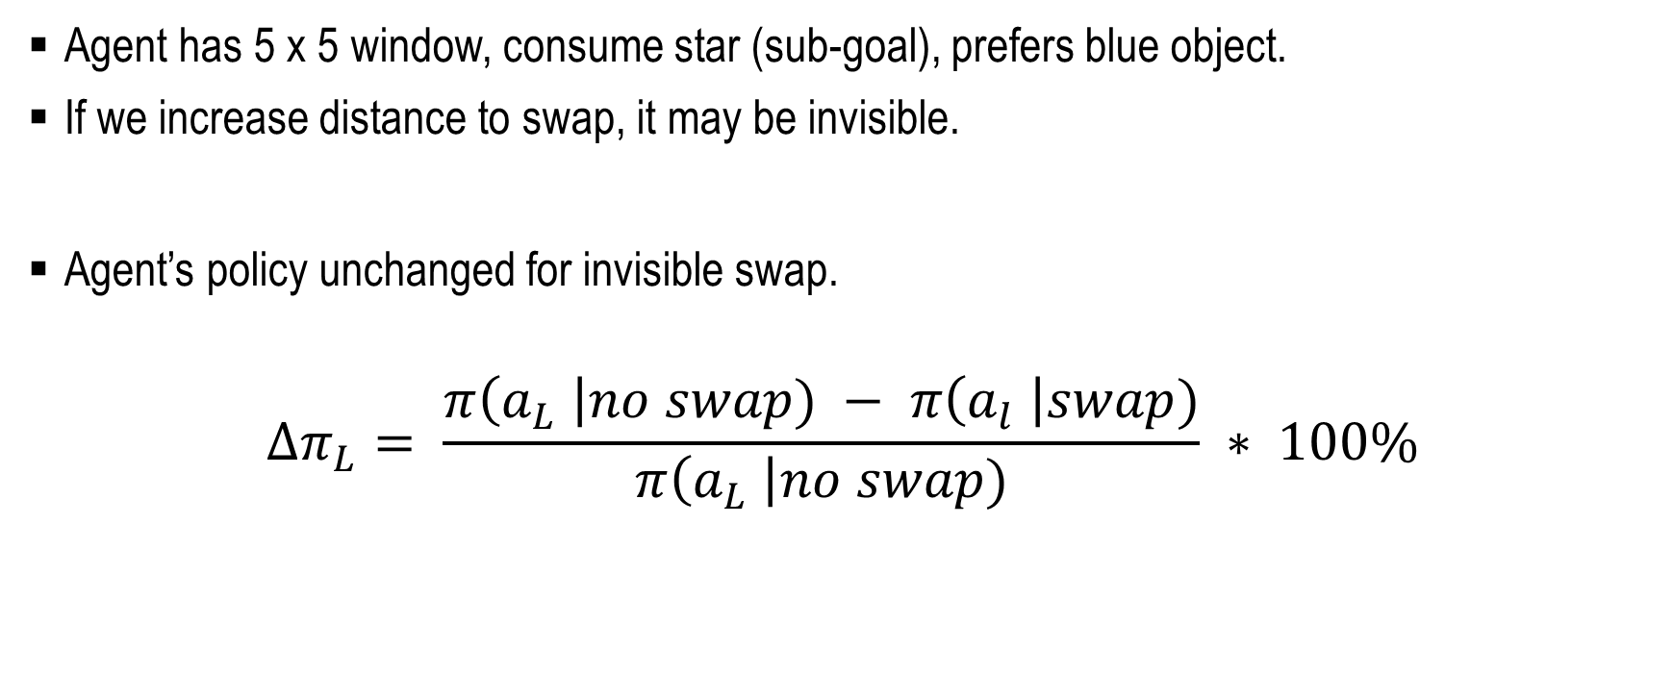
Running the Sally-Anne Test
Agent has 5 x 5 window, consume star (sub-goal), prefers blue object.
If we increase distance to swap, it may be invisible.
Agent’s policy unchanged for invisible swap.
$$∆π_{L}= \frac{π\left(a_{L} \right|no swap) − π\left(a_{l} \right|swap)}{π\left(a_{L} \right|no swap)} ∗ 100\%$$

Slide 48
Running the Sally-Anne Test
True behavior
ToMNet inference

Slide 49
Running the Sally-Anne Test $⇒$It passes! ToMNet $\sim$4 year old IQ

Slide 50
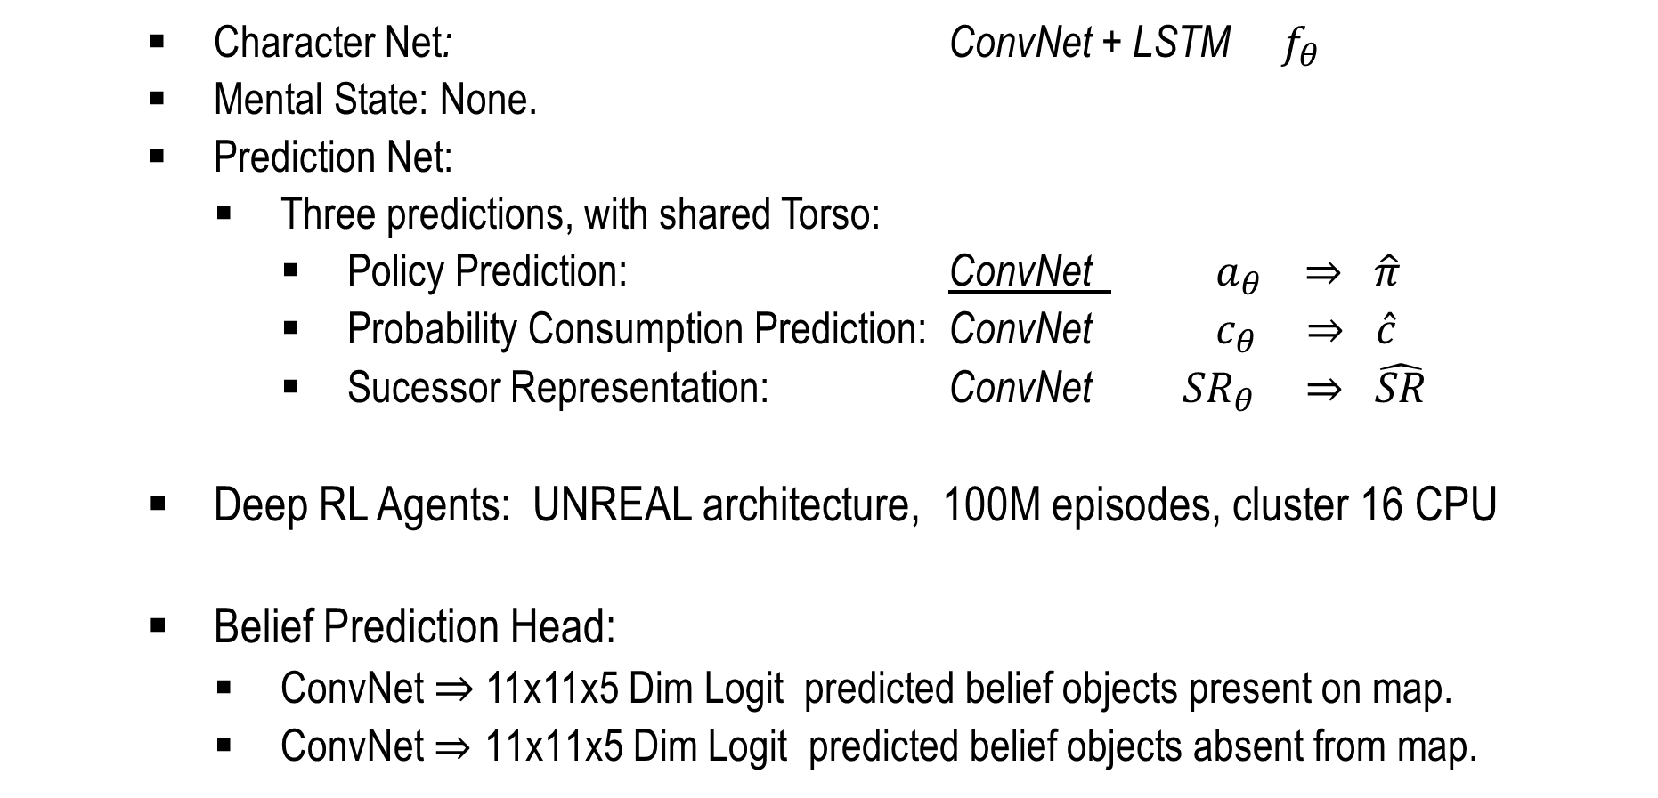
Architecture
Character Net: ConvNet + LSTM $f_{θ }$
Mental State: None.
Prediction Net:
Three predictions, with shared Torso:
Policy Prediction: ConvNet $a_{θ }⇒$ $\hat{π}$
Probability Consumption Prediction: ConvNet $c_{θ }⇒$ $\hat{c}$
Sucessor Representation: ConvNet ${SR}_{θ }⇒$ $\hat{SR}$
Deep RL Agents: UNREAL architecture, 100M episodes, cluster 16 CPU
Belief Prediction Head:
ConvNet $⇒$ 11x11x5 Dim Logit predicted belief objects present on map.
ConvNet $⇒\text{11}\text{x}\text{11}\text{x}\text{5 }\text{Dim} \text{Logit} \text{predicted} \text{belief} \text{objects} \text{absent} \text{from} \text{map}\text{.}$

Slide 51
THANK YOU

